Slide 1
Hello world
"I had a running compiler, and nobody would touch it because, they carefully told me, computers could only do arithmetic; they could not do programs. It was a selling job to get people to try it. I think with any new idea, because people are allergic to change, you have to get out and sell the idea.“
-Grace Hopper

Slide 2
Purpose
Gain experience with as many languages as feasible.
Ada
FORTRAN
ALGOL
COBOL
Pascal
Batch/Shell
Go
VBA
Prolog
Haskell
Malbolge (extra credit)
Lab report is a word document, content is king, formatting is irrelevant as long as readable.
Email lab report to richard.thompson@nps.edu

Slide 3

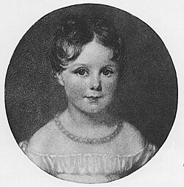
Ada is a structured, statically typed programming language created in the late 1970s and early 1980s, primarily for the U.S. Department of Defense, to address the need for a unified, reliable language for embedded and mission-critical systems.
Origins and Name
The U.S. DoD faced a "software crisis" in the 1970s, using hundreds of programming languages with little compatibility.
Requirements (Steelman documents) were formalized to define what a new language should provide—mainly reliability, safety, and real-time support.
A competition was held, and the winning design (the "Green" team led by Jean Ichbiah of CII Honeywell Bull, France) was selected in 1979.
The language was named "Ada" by US Navy CDR Jack Cooper in honor of Ada Lovelace, considered the first computer programmer.

Slide 4
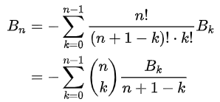
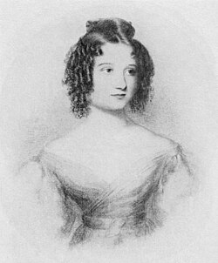
The first program, Note G,
Written for Charles Babbage’s Analytic Engine in the 1840s by Ada Lovelace
Deliberately chose a difficult method to calculate the Bernouli numbers.

Slide 5
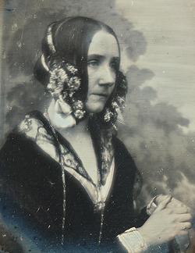
Lab assignment:
Go here: https://www.jdoodle.com/execute-ada-online
Paste the following code, which is Ada’s algorithm
with Ada.Text_IO; use Ada.Text_IO;
procedure Note_G_Bernoulli is
type Var_Array is array(1 .. 21) of Float;
V : Var_Array := (others => 0.0);
N : constant Float := 4.0; -- Lovelace's program constant for V[3]
begin
-- Initialize known values
V(1) := 1.0;
V(2) := 2.0;
V(3) := N;
-- Follow Lovelace's step-by-step operations
V(4) := V(4) - V(1);
V(5) := V(5) + V(1);
V(11) := V(5) / V(4);
V(11) := V(11) / V(2);
V(13) := V(13) - V(11);
V(10) := V(3) - V(1);
V(7) := V(2) + V(7);
V(11) := V(6) / V(7);
V(12) := V(21) * V(11);
V(13) := V(12) + V(13);
V(10) := V(10) - V(1);
V(6) := V(6) - V(1);
V(7) := V(1) + V(7);
-- Output some relevant values to demonstrate progress
Put_Line("V(11) = " & Float'Image(V(11)));
Put_Line("V(13) = " & Float'Image(V(13)));
Put_Line("V(10) = " & Float'Image(V(10)));
end Note_G_Bernoulli;
3. Take a screen shot for your lab report.
4. Answer the questions:
How are variables assigned in Ada?
How are arrays declared?
Where are they declared? Is this good or bad? Why?

Slide 6
FORTRAN
Follow these instructions exactly:
10: go to 40
40 : Navigate to https://www.onlinegdb.com/online_fortran_compiler
50 : go to 20
60: Answer the questions:
Why are goto statements awesome? Why are they not?
Discuss the benefit of restrictions on the programmer?
70: Screen shot the result into your lab report
90: go to 60
20 : Copy and paste the following into the online compiler and go to 60.
program addNumbersWithGoto
implicit none
real :: a, b, result
a = 12.0
b = 15.0
result = a + b
if (result > 20.0) then
goto 10
else
goto 20
end if
10 print *, 'The total is greater than 20'
goto 30
20 print *, 'The total is 20 or less'
30 print *, 'The sum is ', result
end program addNumbersWithGoto
“Gives you enough rope to shoot yourself in the foot”

Slide 7
ALGOL 68
BEGIN
# Recursive factorial function #
PROC factorial = (INT n) INT:
IF n = 0 THEN
1
ELSE
n * factorial(n - 1)
FI;
# Main program block #
INT number;
print(("Enter a non-negative integer: ", newline));
read(number);
# Compute factorial and print result #
print(("Factorial of ", whole(number,0), " is ", whole(factorial(number),0), newline))
END
Designed to be better at scientific computing
Steps
Go to: https://www.tutorialspoint.com/compilers/online-algol-compiler.htm
Compile the code, snapshot the output showing you know the answer.
In ALGOL (especially ALGOL 68), semicolons are used as statement separators, not as terminators. This means semicolons separate adjacent statements within a sequence, but there is no semicolon after the last statement in the sequence. Discuss the benefits of this approach.

Slide 8
COBOL
Built for business users in mind
Run the code in https://www.jdoodle.com/execute-cobol-online
Snip the compiled solution.
Questions:
There is a semantic error in this code. What is it?
How is string concatenation done? Do you like this?
Forget everything about COBOL
IDENTIFICATION DIVISION.
PROGRAM-ID. HELLO-WORLD.
DATA DIVISION.
WORKING-STORAGE SECTION.
77 X PIC 99.
77 Y PIC 99.
77 Z PIC 99.
PROCEDURE DIVISION.
SET X TO 10.
SET Y TO 25.
ADD X Y GIVING Z.
DISPLAY "X + Y = "Z.
STOP RUN.
“The use of COBOL cripples the mind; its teaching should, therefore, be regarded as a criminal offense.”
- Edgar Dijkstra

Slide 9

Pascal
Named after Blaise Pascal
Well liked by many, almost became popular.
Run code, get screenshot. (* https://www.onlinegdb.com/online_pascal_compiler *)
Questions:
If you could design a language, how would you do comments?
{ This is a comment using curly braces }
(* This is a comment using parentheses and asterisk. Weird huh? *)
program PosNegZero;
uses crt;
var
number: Integer;
begin
clrscr;
writeln('Enter an integer: ');
readln(number);
if number > 0 then
writeln('The number is positive.')
else if number < 0 then
writeln('The number is negative.')
else
writeln('The number is zero.');
writeln('Press any key to exit...');
readkey;
end.
“Pascal: A programming language named after a man who would turn over in his grave if he knew about it”
-Unknown

Slide 10
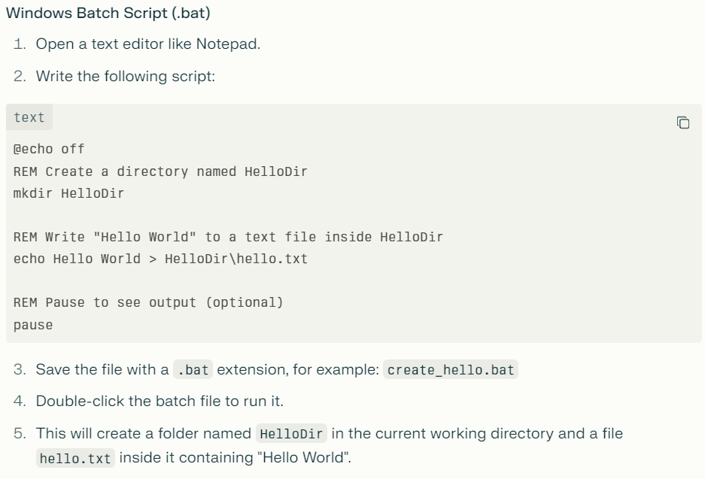
Batch (Windows)
If you are on Windows….

Slide 11
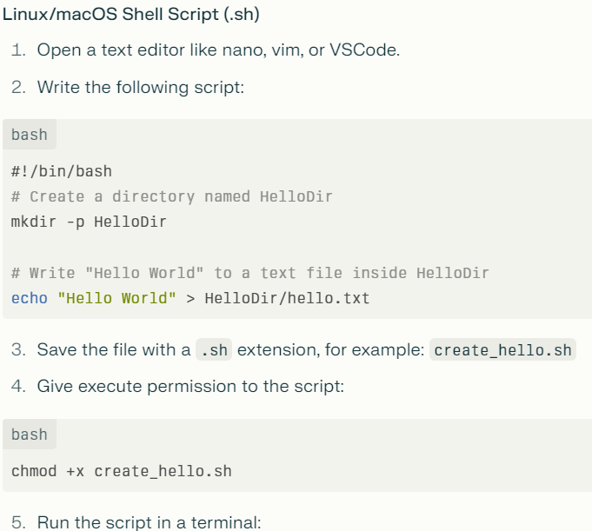
Shell (Linux/Mac)
If you are on Linux/Mac….

Slide 12
Scripting
Instructions
Screenshot text file.
Questions:
What is the difference between > and >> when writing to a file in these scripts?

Slide 13

Go
Released in 2012
From Wikipedia
Static typing and run-time efficiency (like C)
Readability and usability (like Python)
High-performance networking and multiprocessing

Slide 14
Go
package main
import (
"fmt"
"time"
)
func worker(ch chan int) {
time.Sleep(1 * time.Second)
ch <- 42 // Send an integer on the channel
}
func main() {
ch := make(chan int) // type inferred as chan int
var result int // explicitly declared as int
go worker(ch) // start goroutine
fmt.Println("Waiting for worker...")
result = <-ch // receive the int from channel
fmt.Println("Received:", result)
}
Go (haha) to https://go.dev/play/
Insert the code at the right.
Take screen shot and answer the question:
There are two types, ch and result. One is inferred that it will be an int, the other is explicitly declared. What are the benefits to allowing implicit typing?
Is the function worker ever executed in the main thread?

Slide 15
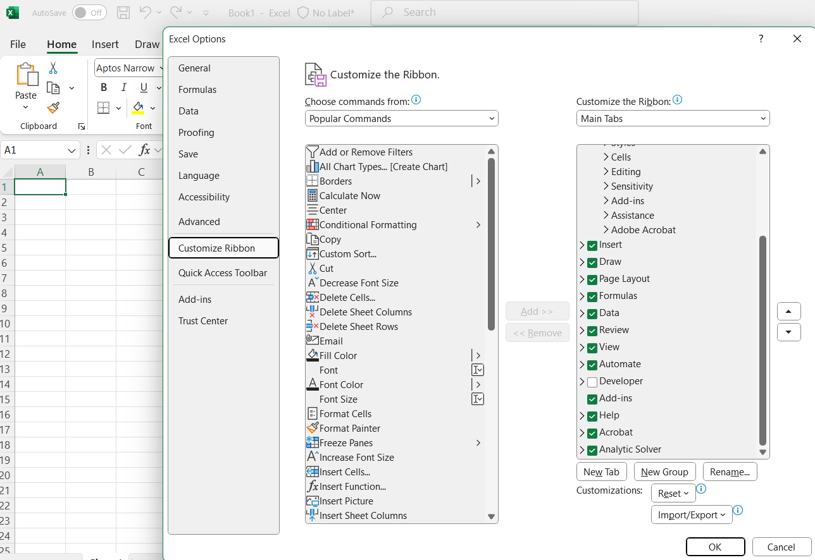
Visual Basic for Applications
Surprisingly common.
Open excel, select the “Developer” check box.
Select the “Developer” Ribbon
Click the “Record Macro” button. Name the macro “Kevin”.
Type “Kevin” in cell B2
Hit “Stop Recording”
Click Macros, and edit “Kevin”
Replace “Kevin” with your name in the code.
Add this line –
MsgBox "Hello, World!", vbOKOnly, "Greeting“
Run Kevin, screenshot message box, answer question:
Why have statement terminators like semi-colons?

Slide 16
Prolog
% Facts
man(john).
woman(mary).
capital_of(france, paris).
% Rule: X is not the same as Y if X is a man and Y is a woman, and they are different.
not_same(X, Y) :- man(X), woman(Y), X \= Y.
% Initial goal predicate
main :-
not_same(john, mary),
capital_of(france, Capital),
format('John and Mary are not the same: true~n', []),
format('Capital of France is ~w~n', [Capital]),
halt.
:- initialization(main).
1. Go here: https://onecompiler.com/prolog
2. Run code, screenshot.
What would happen to the execution if you place the Rule’s section above the Facts section?

Slide 17
Haskell
module Main where
-- Calculate factorial recursively
factorial :: Integer -> Integer
factorial 0 = 1
factorial n = n * factorial (n - 1)
-- Determine if a number is even or odd
evenOrOdd :: Integer -> String
evenOrOdd n
| n `mod` 2 == 0 = "even"
| otherwise = "odd"
main :: IO ()
main = do
let squares = [x * x | x <- [1..10]]
print squares
let number = 5 :: Integer
putStrLn ("Factorial of " ++ show number ++ " is " ++ show (factorial number))
putStrLn ("The number " ++ show number ++ " is " ++ evenOrOdd number)
A Function does not change the state of an object. It is deterministic and predictable. The same input always produces the same output. Haskell loves functions. Embracing this paradigm can make your code more functional (haha).
Run code on https://play.haskell.org/
Screen shot output, answer question:
Explain the function header:
evenOrOdd :: Integer -> String
What is meant by evenOrOdd,
Integer, and String?

Slide 18
Extra Credit - Malbolge
Automatic A in the class – Implement Euclid’s algorithm.
No vibe coding, no tools that you did not make yourself.

